Slide 2
Agenda
当前金融体系和环境
传统金融体系的局限性
区块链方案的解决之道

Slide 3
1
当前金融体系和环境

Slide 4
金融体系-中东/阿曼
银行是金融体系主体，货币挂钩美元，资本市场不发达
外汇管理 | 银行和保险 | 融资服务 | 证券市场
央行成立于1974 美元存款占总存款 90% 美元贷款占总贷款97% | 银行资产负债占金融总资产负债90% 16家商业银行中，7家本地，9家外国银行 保险公司共22家，阿拉伯公司7家，外国公司4家 | 项目融资集团 2016年商业银行贷款总额575.4亿美元 平均贷款利率4.8% | 1989年马斯喀特证券市场（MSM）负责运营 资本市场监管局（CMA）负责监管 2016年MSM上市公司120家，市值449.5亿，日均交易额396万

Slide 5
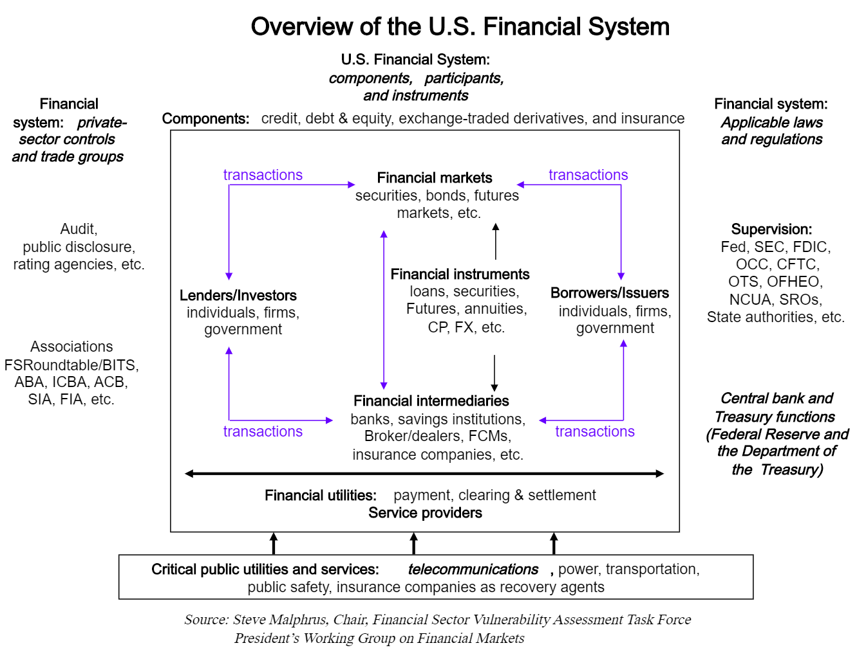
金融体系-美国

Slide 6
金融体系-中国
银行间市场
证券交易所
期货交易所
其它交易所
OTC
人民银行
卖方市场
买方市场
服务商
银保监会
信托
券商
投行
小贷
保险
期货
基金
评级
结算
银行
资产
管理
担保
汽车
金融
…
支付
…
证监会
典当
清收

Slide 7
2
传统金融体系的局限性

Slide 8
阿曼的经济和金融
依赖石油和美元导致对外经济敏感，造成赤字和失业率增加
全球环境下的阿曼经济
油价波动导致金融体系受损
油价长期下跌导致盈利能力下降
财政赤字已经缩小，但依然较大
失业率达到17.8%
石油化工产品产量不会大幅增加
受美元影响的金融体系
货币政策缺乏灵活性
资本市场不发达，融资单一且效低效
债务上升到GDP的50%，其中70%是外币债务
银行资产质量下降，违约概率升高
美元加息导致贷款利率上升

Slide 9
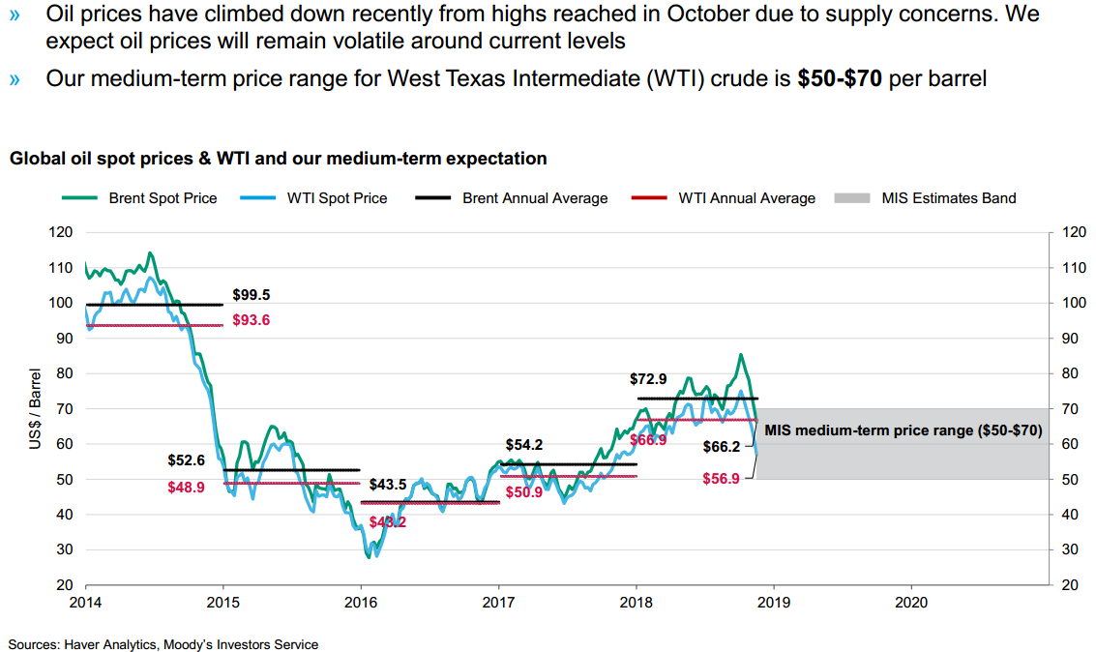
石油产品价格趋势

Slide 10
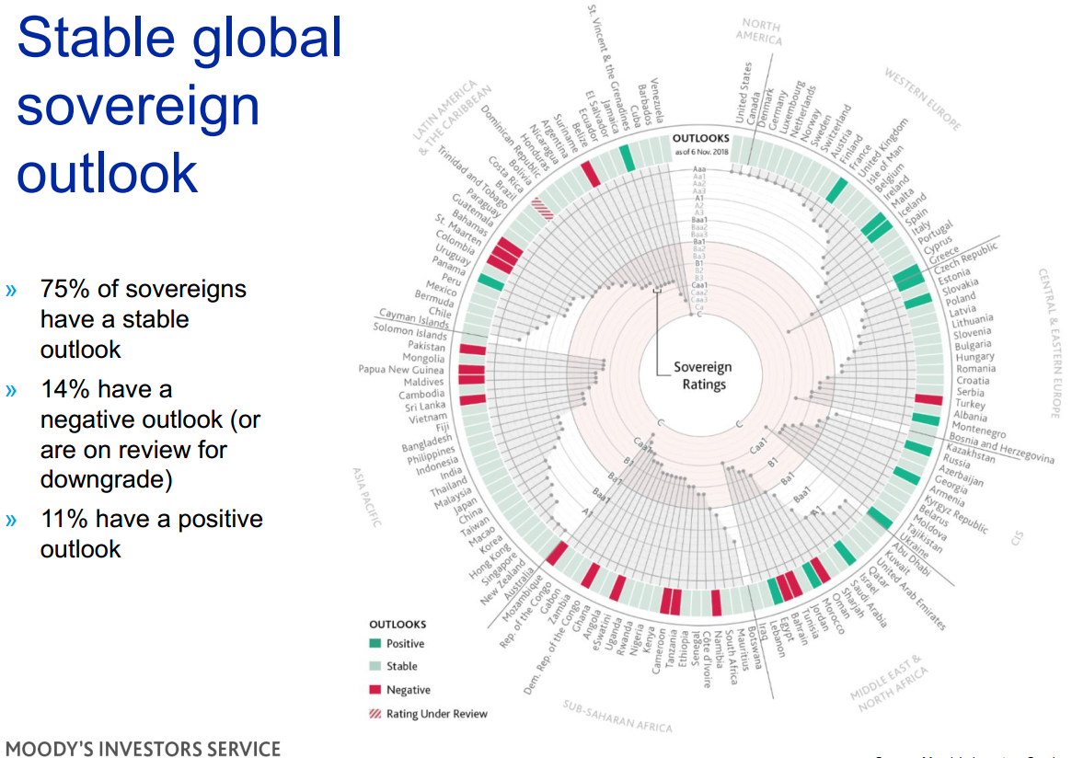
全球的主权评级
接近投机级

Slide 11
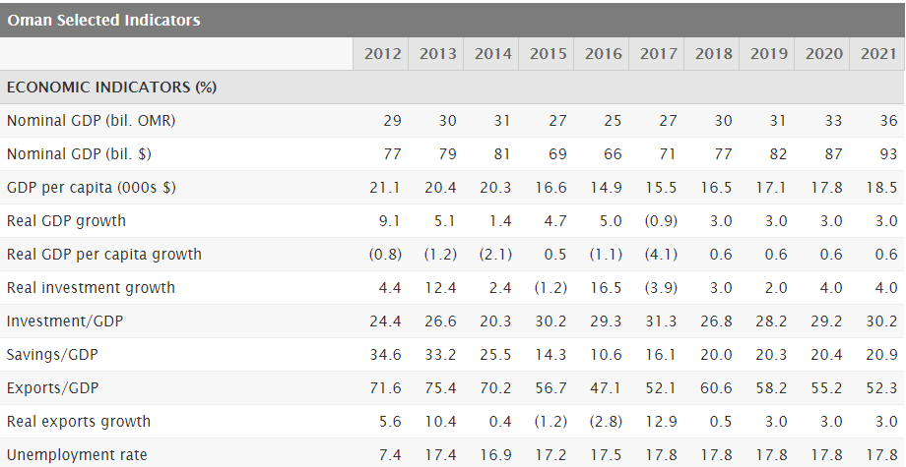
阿曼的经济数据-摘要
GDP增长率和失业率影响经济（数据来源于标普）

Slide 12
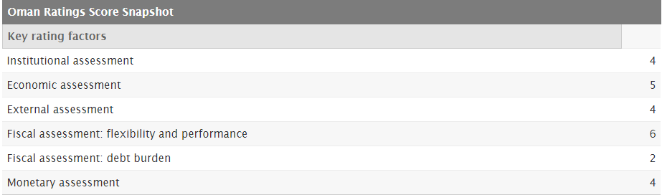
评级机构对阿曼的评分
财政负担影响经济（数据来源于标普）

Slide 13
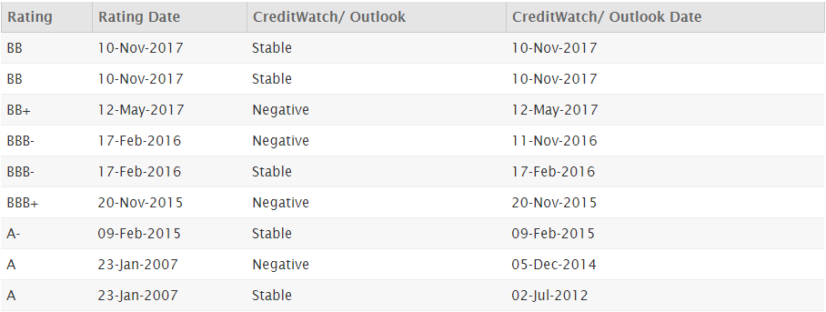
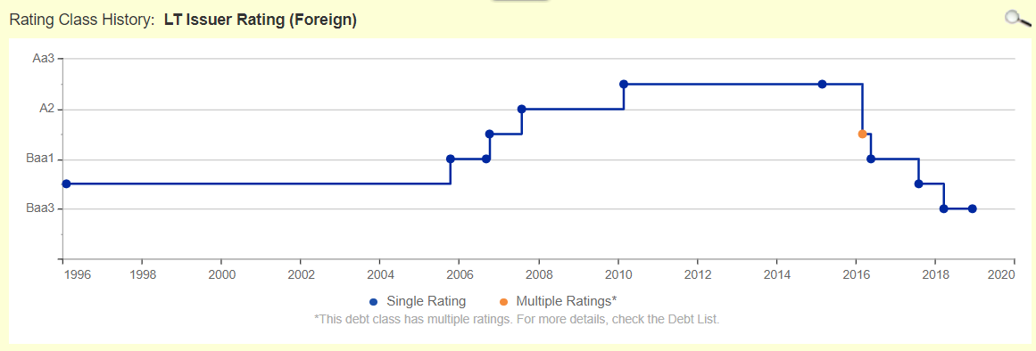
评级机构对阿曼的评分
阿曼的评级历史（穆迪&标普）

Slide 14
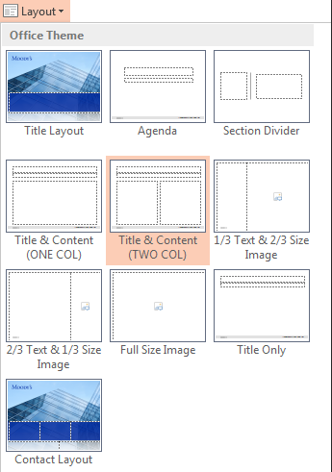
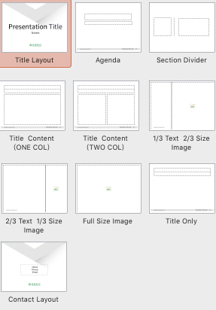
机遇-区块链&金融科技
传统方式难以解决问题并改变现状，区块链将是重大机遇
当前面临的问题的总结：
1
2
3
区块链发挥的价值：
区块链技术先进可以帮助传统行业进步
区块链项目可以创造收入
区块链经济可以改变行业格局

Slide 15
3
区块链方案的解决之道

Slide 16
区块链关键概念
More table styles available in the PowerPoint Toolkit
Table Heading 01 | Table Heading 02 | Table Heading 03 | Table Heading 04
SNC's is an essential component of the global capital markets, providing credit ratings, research, tools and analysis. | SNC's is an essential component of the global capital markets, providing credit ratings, research, tools and analysis. | SNC's is an essential component of the global capital markets, providing credit ratings, research, tools and analysis. | SNC's is an essential component of the global capital markets, providing credit ratings, research, tools and analysis.
Parent company of MIS and MA Contributes to transparent and integrated financial markets | Parent company of MIS and MA Contributes to transparent and integrated financial markets | Parent company of MIS and MA Contributes to transparent and integrated financial markets | Parent company of MIS and MA Contributes to transparent and integrated financial markets

Slide 17
全球区块链的生态
More table styles available in the PowerPoint Toolkit
Table Heading 01 | Table Heading 02 | Table Heading 03 | Table Heading 04
SNC's is an essential component of the global capital markets, providing credit ratings, research, tools and analysis. | SNC's is an essential component of the global capital markets, providing credit ratings, research, tools and analysis. | SNC's is an essential component of the global capital markets, providing credit ratings, research, tools and analysis. | SNC's is an essential component of the global capital markets, providing credit ratings, research, tools and analysis.
Parent company of MIS and MA Contributes to transparent and integrated financial markets | Parent company of MIS and MA Contributes to transparent and integrated financial markets | Parent company of MIS and MA Contributes to transparent and integrated financial markets | Parent company of MIS and MA Contributes to transparent and integrated financial markets

Slide 18
关键点和应对策略
交易所是核心和关键
交易所是关键的理由
1
2
3
Credit ratings
Research
Tools & analysis

Slide 19

革新
传统方法逐渐失效，区块链经济带来希望和活力
发展
区块链从技术和经济两方面，帮助原金融体系更独立更健壮
进步
紧跟时代脚步，采用最新技术和理念获得优势摆脱束缚

Slide 20
Q & A

Slide 21
One column text + chart
More chart styles in the PowerPoint toolkit
SNC’s Overview
Essential component of the global capital markets
Parent company of MIS and MA
Contributes to transparent and integrated financial markets
Provides:
Credit ratings
Research
Tools & analysis

Slide 22
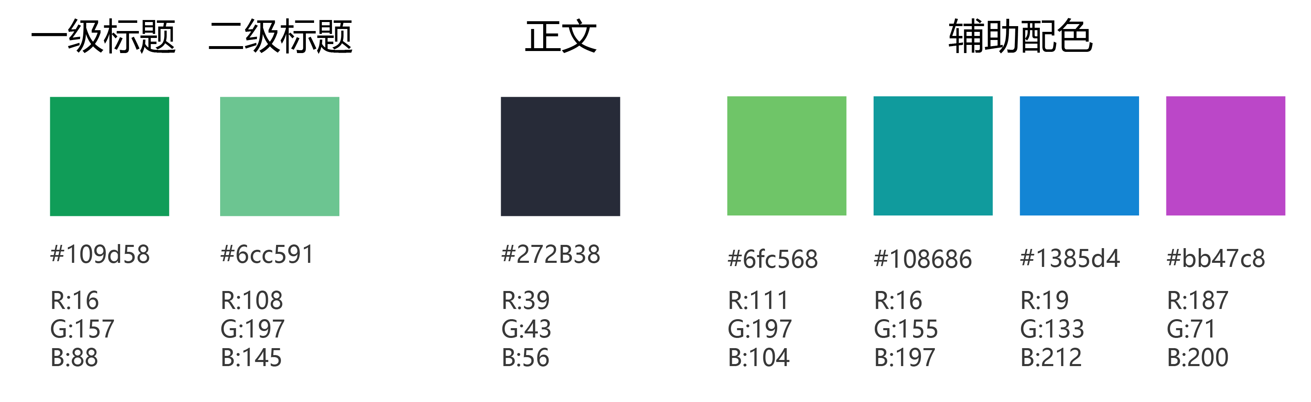
Note 2: the font
Find this toolbar next to the “Home” tab
Font：微软雅黑（Mac系统下文字自动转为苹方）
Color:

Slide 23
Note 1: slide masters
Choose the right slide for the right job
The layouts of all the slides in this template are derived from the PowerPoint “slide masters,” which are accessible from the HOME tab as well as within the SNC’S TOOLS toolbar.
You can choose a layout for your slides by clicking on the Layout button and selecting the desired layout from the flyout menu. To restore your slide to the original layout of the slide master, use the reset function:

Slide 24
One column slide with larger text
Best for presenting a few main points
SNC’s Corporation Overview
Essential component of the global capital markets
Parent company of MIS and MA
Contributes to transparent and integrated financial markets
Provides credit ratings, research, tools & analysis

Slide 25
Two column slide with smaller text
Text boxes are separated for easier editing
SNC’s Overview
Essential component of the global capital markets
Parent company of MIS and MA
Contributes to transparent and integrated financial markets
Provides:
Credit ratings
Research
Tools & analysis
Company Details
Moody's is an essential component of the global capital markets, providing credit ratings, research, tools and analysis that contribute to transparent and integrated financial markets.
Moody's Corporation is the parent company of Moody's Investors Service and Moody's Analytics.

Slide 26

One column text + image
SNC’s Overview
Essential component of the global capital markets
Parent company of MIS and MA
Contributes to transparent and integrated financial markets
Moody’s provides credit ratings, research, tools & analysis

Slide 27
1/3 Text & 2/3 Image Layout
Use this layout when showing a strong visual alongside a small amount of text.
To add your own image, delete the photo and then click the icon that appears underneath.
For help with positioning, select VIEW > Guides

Slide 28
2/3 Text & 1/3 Image Layout
Use this layout when showing a strong visual alongside a large amount of text.
To add your own image, delete the photo and then click the icon that appears underneath.
For help with positioning, select VIEW > Guides

Slide 29
Full size image slide shown here
Best for presenting only a few points
Use icons from the PowerPoint Toolkit

Slide 30
© 2017 Moody’s Corporation, Moody’s Investors Service, Inc., Moody’s Analytics, Inc. and/or their licensors and affiliates (collectively, “MOODY’S”). All rights reserved.
CREDIT RATINGS ISSUED BY MOODY'S INVESTORS SERVICE, INC. AND ITS RATINGS AFFILIATES (“MIS”) ARE MOODY’S CURRENT OPINIONS OF THE RELATIVE FUTURE CREDIT RISK OF ENTITIES, CREDIT COMMITMENTS, OR DEBT OR DEBT-LIKE SECURITIES, AND MOODY’S PUBLICATIONS MAY INCLUDE MOODY’S CURRENT OPINIONS OF THE RELATIVE FUTURE CREDIT RISK OF ENTITIES, CREDIT COMMITMENTS, OR DEBT OR DEBT-LIKE SECURITIES. MOODY’S DEFINES CREDIT RISK AS THE RISK THAT AN ENTITY MAY NOT MEET ITS CONTRACTUAL, FINANCIAL OBLIGATIONS AS THEY COME DUE AND ANY ESTIMATED FINANCIAL LOSS IN THE EVENT OF DEFAULT. CREDIT RATINGS DO NOT ADDRESS ANY OTHER RISK, INCLUDING BUT NOT LIMITED TO: LIQUIDITY RISK, MARKET VALUE RISK, OR PRICE VOLATILITY. CREDIT RATINGS AND MOODY’S OPINIONS INCLUDED IN MOODY’S PUBLICATIONS ARE NOT STATEMENTS OF CURRENT OR HISTORICAL FACT. MOODY’S PUBLICATIONS MAY ALSO INCLUDE QUANTITATIVE MODEL-BASED ESTIMATES OF CREDIT RISK AND RELATED OPINIONS OR COMMENTARY PUBLISHED BY MOODY’S ANALYTICS, INC. CREDIT RATINGS AND MOODY’S PUBLICATIONS DO NOT CONSTITUTE OR PROVIDE INVESTMENT OR FINANCIAL ADVICE, AND CREDIT RATINGS AND MOODY’S PUBLICATIONS ARE NOT AND DO NOT PROVIDE RECOMMENDATIONS TO PURCHASE, SELL, OR HOLD PARTICULAR SECURITIES. NEITHER CREDIT RATINGS NOR MOODY’S PUBLICATIONS COMMENT ON THE SUITABILITY OF AN INVESTMENT FOR ANY PARTICULAR INVESTOR. MOODY’S ISSUES ITS CREDIT RATINGS AND PUBLISHES MOODY’S PUBLICATIONS WITH THE EXPECTATION AND UNDERSTANDING THAT EACH INVESTOR WILL, WITH DUE CARE, MAKE ITS OWN STUDY AND EVALUATION OF EACH SECURITY THAT IS UNDER CONSIDERATION FOR PURCHASE, HOLDING, OR SALE.
MOODY’S CREDIT RATINGS AND MOODY’S PUBLICATIONS ARE NOT INTENDED FOR USE BY RETAIL INVESTORS AND IT WOULD BE RECKLESS AND INAPPROPRIATE FOR RETAIL INVESTORS TO USE MOODY’S CREDIT RATINGS OR MOODY’S PUBLICATIONS WHEN MAKING AN INVESTMENT DECISION. IF IN DOUBT YOU SHOULD CONTACT YOUR FINANCIAL OR OTHER PROFESSIONAL ADVISER.
ALL INFORMATION CONTAINED HEREIN IS PROTECTED BY LAW, INCLUDING BUT NOT LIMITED TO, COPYRIGHT LAW, AND NONE OF SUCH INFORMATION MAY BE COPIED OR OTHERWISE REPRODUCED, REPACKAGED, FURTHER TRANSMITTED, TRANSFERRED, DISSEMINATED, REDISTRIBUTED OR RESOLD, OR STORED FOR SUBSEQUENT USE FOR ANY SUCH PURPOSE, IN WHOLE OR IN PART, IN ANY FORM OR MANNER OR BY ANY MEANS WHATSOEVER, BY ANY PERSON WITHOUT MOODY’S PRIOR WRITTEN CONSENT.
All information contained herein is obtained by MOODY’S from sources believed by it to be accurate and reliable. Because of the possibility of human or mechanical error as well as other factors, however, all information contained herein is provided “AS IS” without warranty of any kind. MOODY'S adopts all necessary measures so that the information it uses in assigning a credit rating is of sufficient quality and from sources MOODY'S considers to be reliable including, when appropriate, independent third-party sources. However, MOODY’S is not an auditor and cannot in every instance independently verify or validate information received in the rating process or in preparing the Moody’s publications.
To the extent permitted by law, MOODY’S and its directors, officers, employees, agents, representatives, licensors and suppliers disclaim liability to any person or entity for any indirect, special, consequential, or incidental losses or damages whatsoever arising from or in connection with the information contained herein or the use of or inability to use any such information, even if MOODY’S or any of its directors, officers, employees, agents, representatives, licensors or suppliers is advised in advance of the possibility of such losses or damages, including but not limited to: (a) any loss of present or prospective profits or (b) any loss or damage arising where the relevant financial instrument is not the subject of a particular credit rating assigned by MOODY’S.
To the extent permitted by law, MOODY’S and its directors, officers, employees, agents, representatives, licensors and suppliers disclaim liability for any direct or compensatory losses or damages caused to any person or entity, including but not limited to by any negligence (but excluding fraud, willful misconduct or any other type of liability that, for the avoidance of doubt, by law cannot be excluded) on the part of, or any contingency within or beyond the control of, MOODY’S or any of its directors, officers, employees, agents, representatives, licensors or suppliers, arising from or in connection with the information contained herein or the use of or inability to use any such information.
NO WARRANTY, EXPRESS OR IMPLIED, AS TO THE ACCURACY, TIMELINESS, COMPLETENESS, MERCHANTABILITY OR FITNESS FOR ANY PARTICULAR PURPOSE OF ANY SUCH RATING OR OTHER OPINION OR INFORMATION IS GIVEN OR MADE BY MOODY’S IN ANY FORM OR MANNER WHATSOEVER.
Moody’s Investors Service, Inc., a wholly-owned credit rating agency subsidiary of Moody’s Corporation (“MCO”), hereby discloses that most issuers of debt securities (including corporate and municipal bonds, debentures, notes and commercial paper) and preferred stock rated by Moody’s Investors Service, Inc. have, prior to assignment of any rating, agreed to pay to Moody’s Investors Service, Inc. for appraisal and rating services rendered by it fees ranging from $1,500 to approximately $2,500,000. MCO and MIS also maintain policies and procedures to address the independence of MIS’s ratings and rating processes. Information regarding certain affiliations that may exist between directors of MCO and rated entities, and between entities who hold ratings from MIS and have also publicly reported to the SEC an ownership interest in MCO of more than 5%, is posted annually at www.moodys.com under the heading “Investor Relations — Corporate Governance — Director and Shareholder Affiliation Policy.”
Additional terms for Australia only: Any publication into Australia of this document is pursuant to the Australian Financial Services License of MOODY’S affiliate, Moody’s Investors Service Pty Limited ABN 61 003 399 657AFSL 336969 and/or Moody’s Analytics Australia Pty Ltd ABN 94 105 136 972 AFSL 383569 (as applicable). This document is intended to be provided only to “wholesale clients” within the meaning of section 761G of the Corporations Act 2001. By continuing to access this document from within Australia, you represent to MOODY’S that you are, or are accessing the document as a representative of, a “wholesale client” and that neither you nor the entity you represent will directly or indirectly disseminate this document or its contents to “retail clients” within the meaning of section 761G of the Corporations Act 2001. MOODY’S credit rating is an opinion as to the creditworthiness of a debt obligation of the issuer, not on the equity securities of the issuer or any form of security that is available to retail investors. It would be reckless and inappropriate for retail investors to use MOODY’S credit ratings or publications when making an investment decision. If in doubt you should contact your financial or other professional adviser.
Additional terms for Japan only: Moody's Japan K.K. (“MJKK”) is a wholly-owned credit rating agency subsidiary of Moody's Group Japan G.K., which is wholly-owned by Moody’s Overseas Holdings Inc., a wholly-owned subsidiary of MCO. Moody’s SF Japan K.K. (“MSFJ”) is a wholly-owned credit rating agency subsidiary of MJKK. MSFJ is not a Nationally Recognized Statistical Rating Organization (“NRSRO”). Therefore, credit ratings assigned by MSFJ are Non-NRSRO Credit Ratings. Non-NRSRO Credit Ratings are assigned by an entity that is not a NRSRO and, consequently, the rated obligation will not qualify for certain types of treatment under U.S. laws. MJKK and MSFJ are credit rating agencies registered with the Japan Financial Services Agency and their registration numbers are FSA Commissioner (Ratings) No. 2 and 3 respectively.
MJKK or MSFJ (as applicable) hereby disclose that most issuers of debt securities (including corporate and municipal bonds, debentures, notes and commercial paper) and preferred stock rated by MJKK or MSFJ (as applicable) have, prior to assignment of any rating, agreed to pay to MJKK or MSFJ (as applicable) for appraisal and rating services rendered by it fees ranging from JPY200,000 to approximately JPY350,000,000.
MJKK and MSFJ also maintain policies and procedures to address Japanese regulatory requirements.

Slide 31

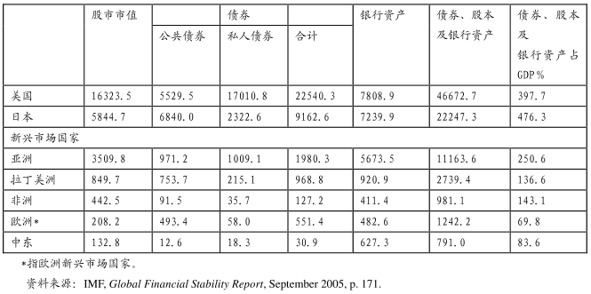
金融体系-中东/阿曼
央行外汇管理较弱，挂钩美元。银行是金融主要力量。

Slide 32
阿曼的经济问题
依赖石油和美元导致对外部经济敏感，造成赤字和失业率增加
阿曼金融体系面临的问题
地缘政治：OPEC、石油产量
石油美元
失业率高
阿拉伯国家金融自由化比较缓慢且犹豫不定
阿拉伯国家信息技术尚落后于世界其他地区，这将成为金融行业变革的巨大障碍，并影响其全面发展的潜力
阿拉伯国家需要多样化的金融服务，包括微观金融、小规模商业融资、住房抵押、可持续养老金、保险服务、其他规避风险的产品以及大型项目融资等。尽管阿拉伯国家金融体系包括这些服务，但其作用和世界其他地区相比还较弱。
评级下调

